Slide 1
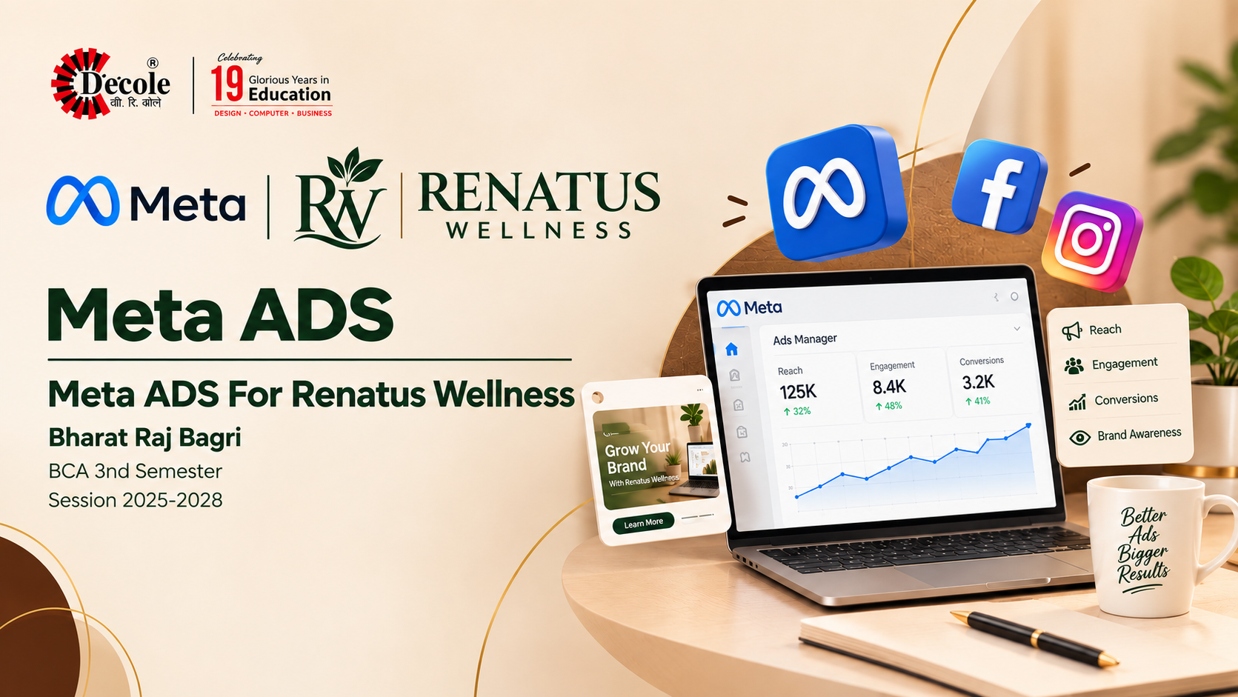

Slide 2

Assignment Report
Digital Marketing
ASSIGNMENT FOLIO
Assignment Folio of
Digital Marketing
Submitted to
Dezyne École College
Toward Digital Marketing
By
BCA
3rd Semester
Bharat Raj Bagri
Dezyne École College
106/10, Civil Lines, Ajmer
www.dezyneecole.com

Slide 3
Digital Marketing
Acknowledgement
ASSIGNMENT FOLIO
We take this opportunity to express our sincere gratitude to Dezyne École College for providing us with the knowledge, resources, and guidance essential to the successful completion of this project.
Our deepest thanks to our respected Principal, Dr. Vinita Mathur, for her visionary leadership and continuous encouragement. Her commitment to academic excellence and student growth has been a constant source of motivation and pride.
We are equally thankful to all our faculty members for their consistent support, expert advice, and valuable insights that shaped our learning and helped us achieve this milestone.
Lastly, we extend heartfelt thanks to everyone who directly or indirectly contributed to the success of this project.
We are proud to be part of Dezyne École College, an institution that truly nurtures professionalism, innovation, and purpose.
With sincere appreciation,
Bharat Raj Bagri
Department – BCA
Dezyne École College, Ajmer

Slide 4
Digital Marketing
Case Study
--------------------------------------------------------------------------------------------------------------------------------------------------------------------------------
ASSIGNMENT FOLIO
Objective:
Increase Instagram Profile Visits, Boost Brand Awareness, Grow Followers Organically, Increase Engagement Rate & Improve Content Reach.
1. Traffic Campaign Objective
Selected the “Traffic” objective in Meta Ads Manager to drive Instagram profile visits.
2. Audience Targeting
Targeted users based on age, interests, behavior, and location.
3.Engaging Creative Content
Used eye-catching Reels, carousel posts, and strong captions
4. Call-to-Action Button
Used “Visit Instagram Profile” to direct users instantly
5. Performance Tracking
Monitored metrics like CTR, Profile Visits, CPC, and Engagement Rate
--------------------------------------------------------------------------------------------------------------------------------------------------------------------------------

Slide 5
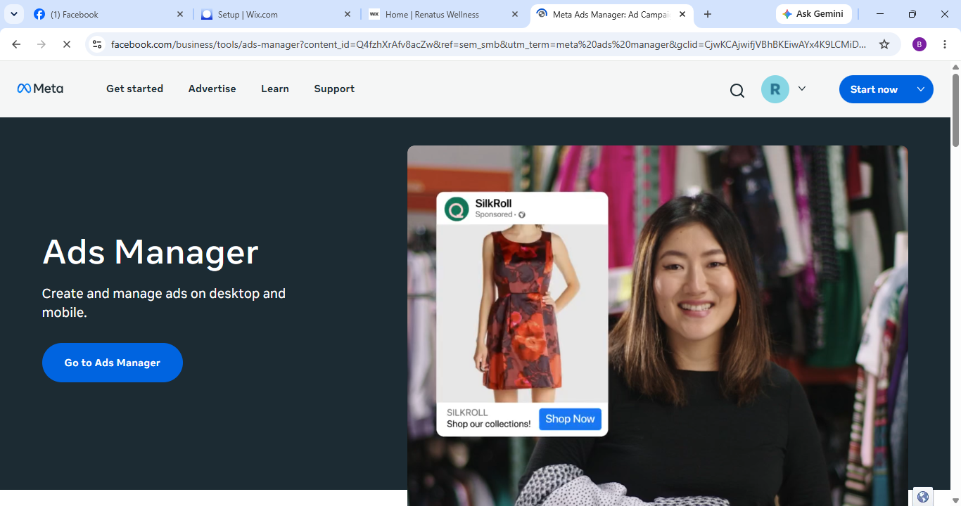
Meta Overview

Slide 6
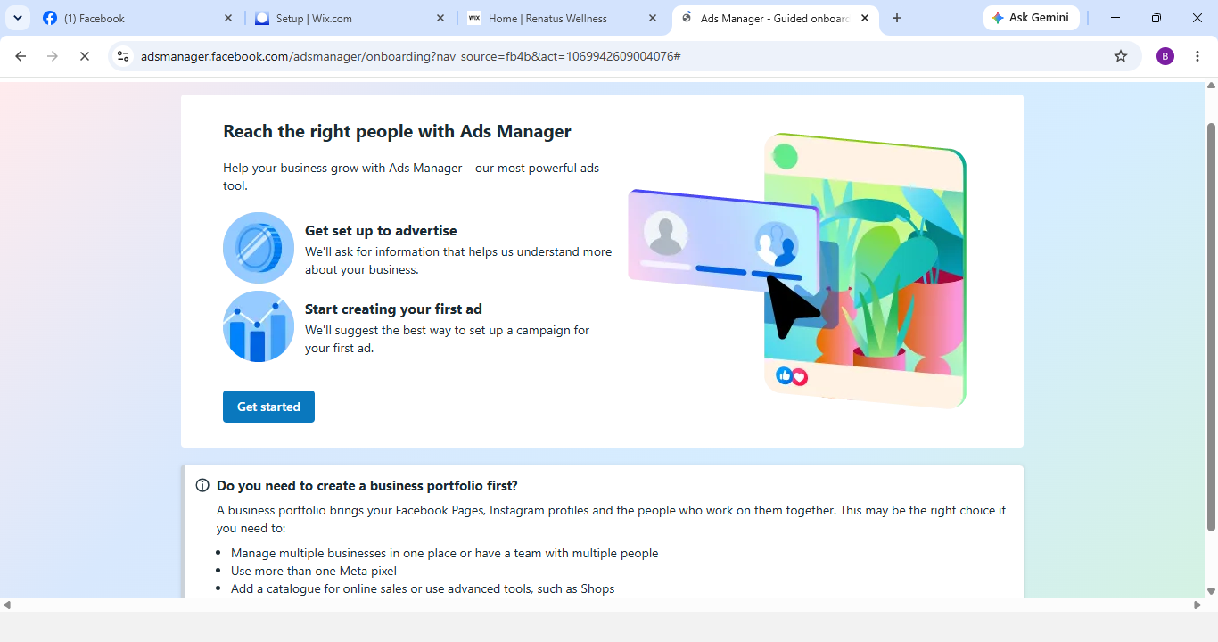
Meta Overview

Slide 7
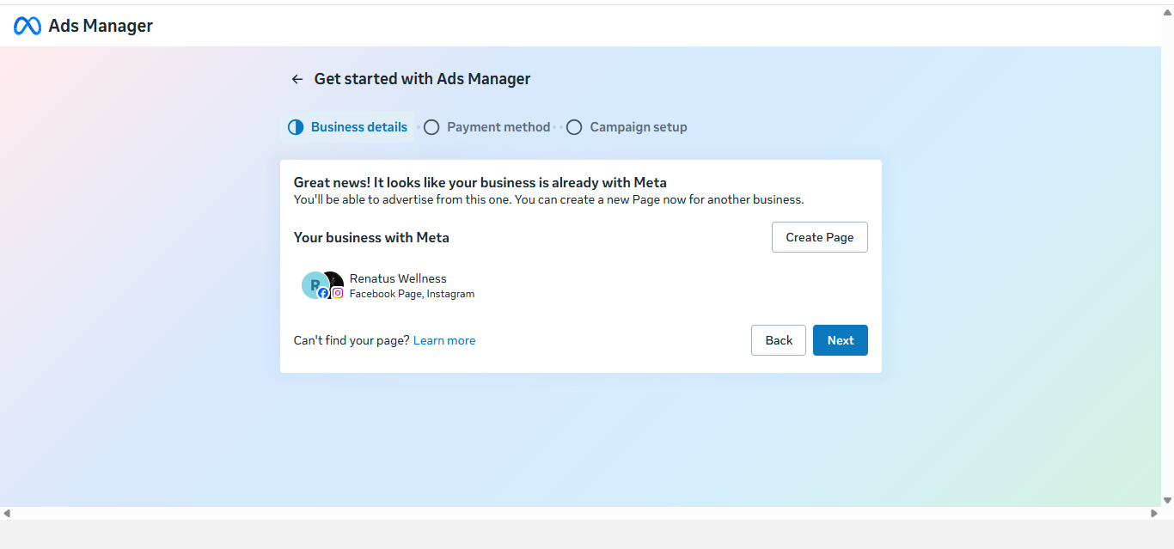
Business Information

Slide 8
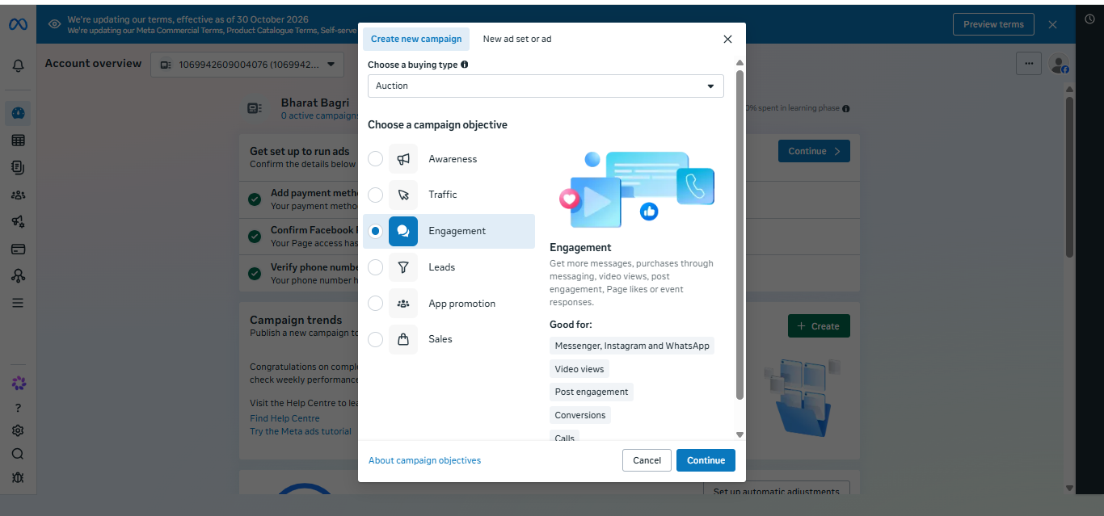
Create New Campaign

Slide 9
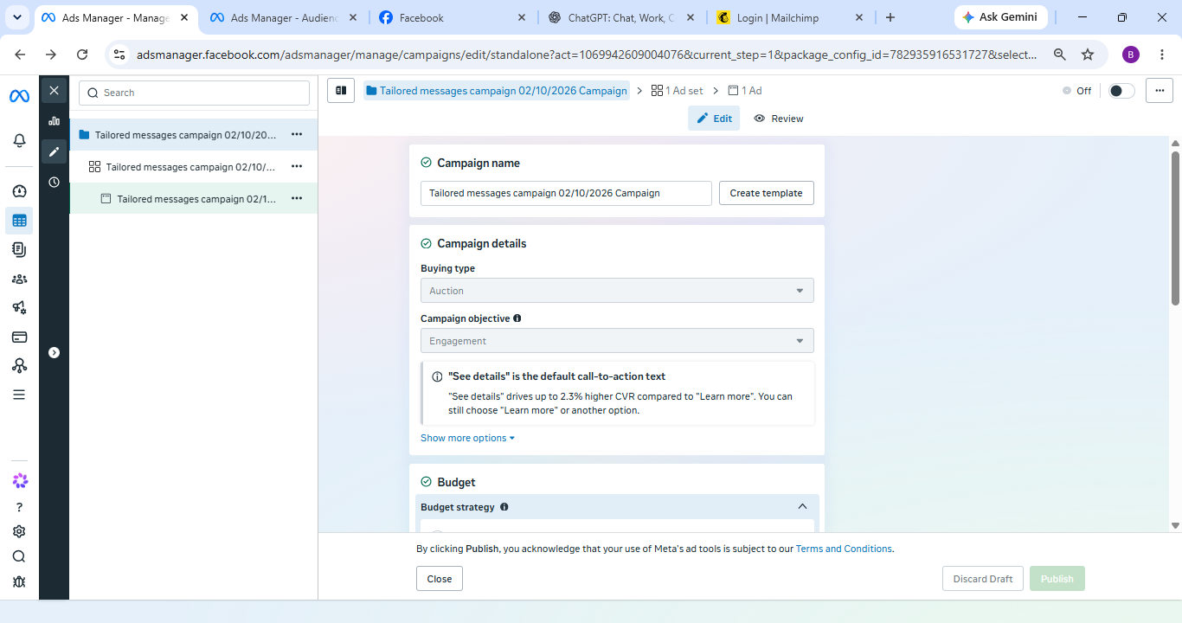
New Engagement Campaign

Slide 10
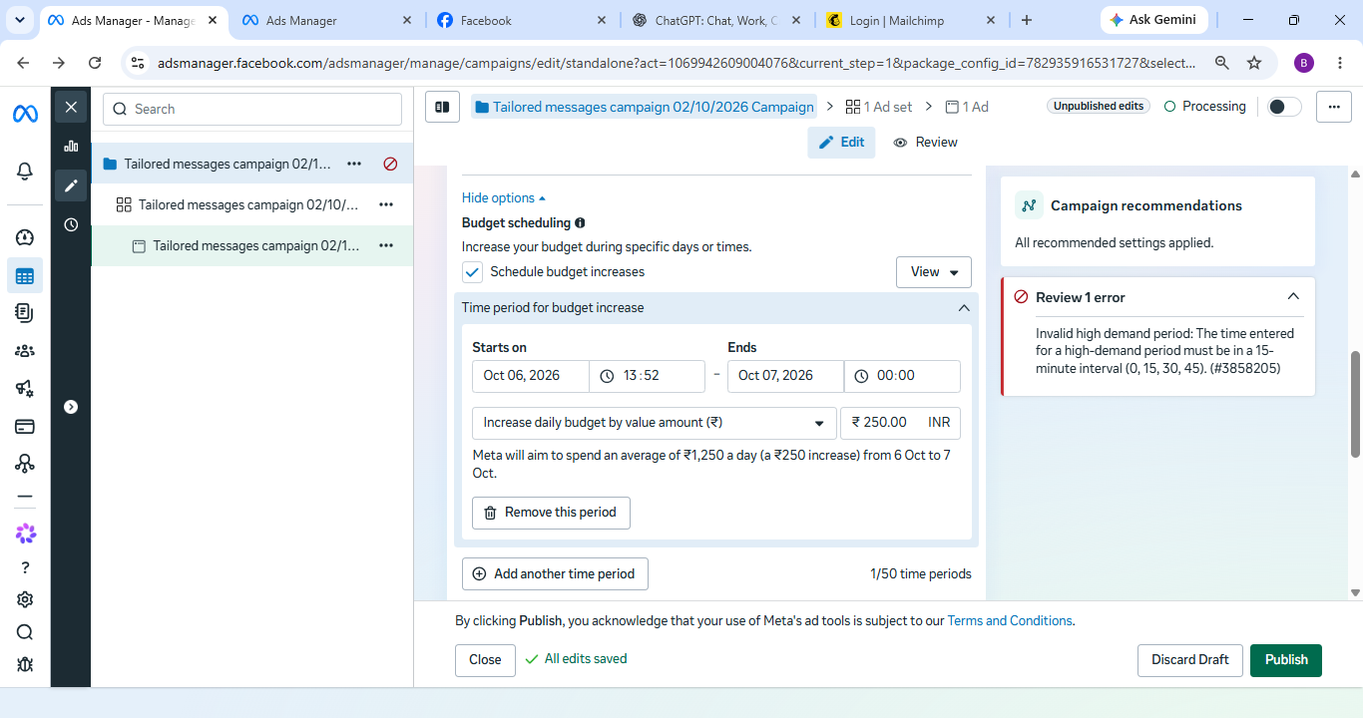
Budget Scheduling

Slide 11
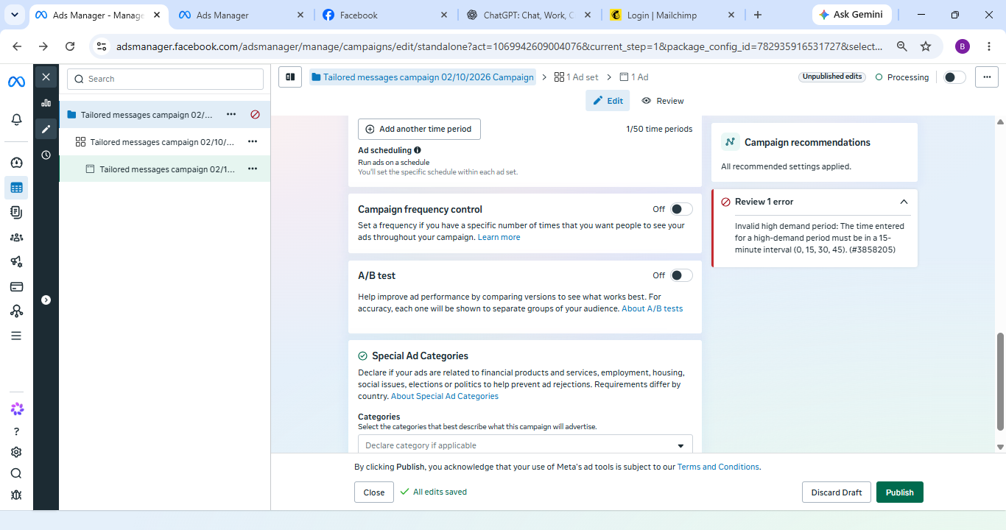
Add Scheduling

Slide 12
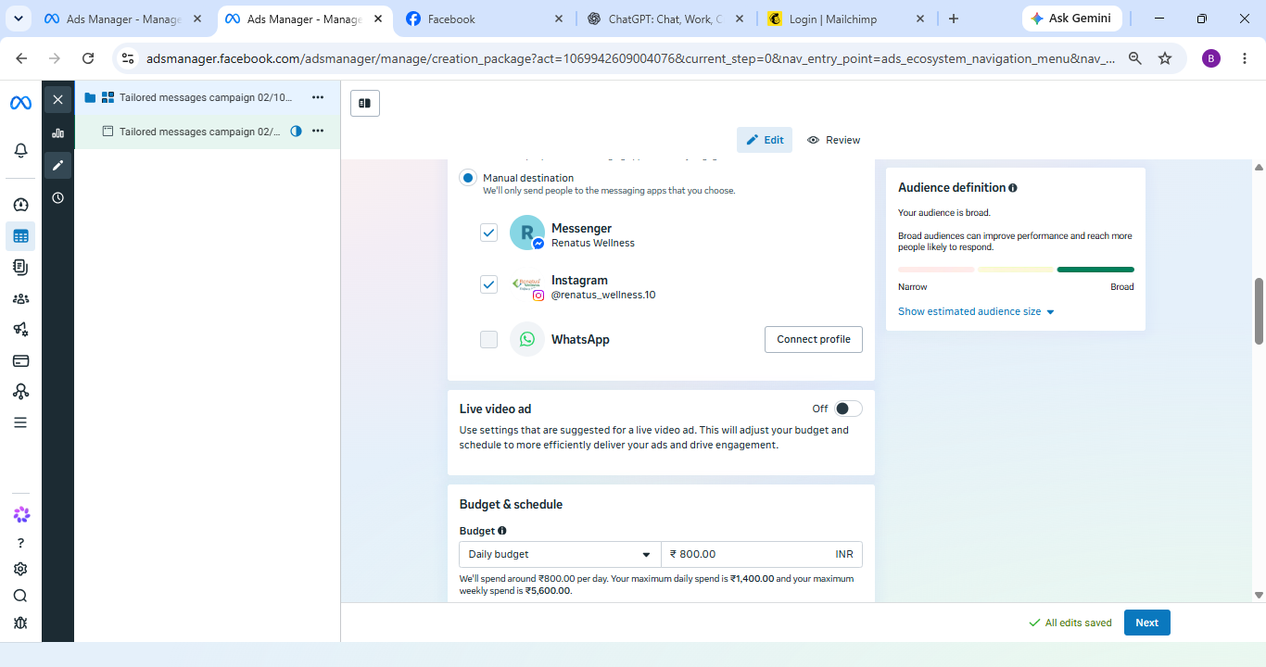
Connections

Slide 13
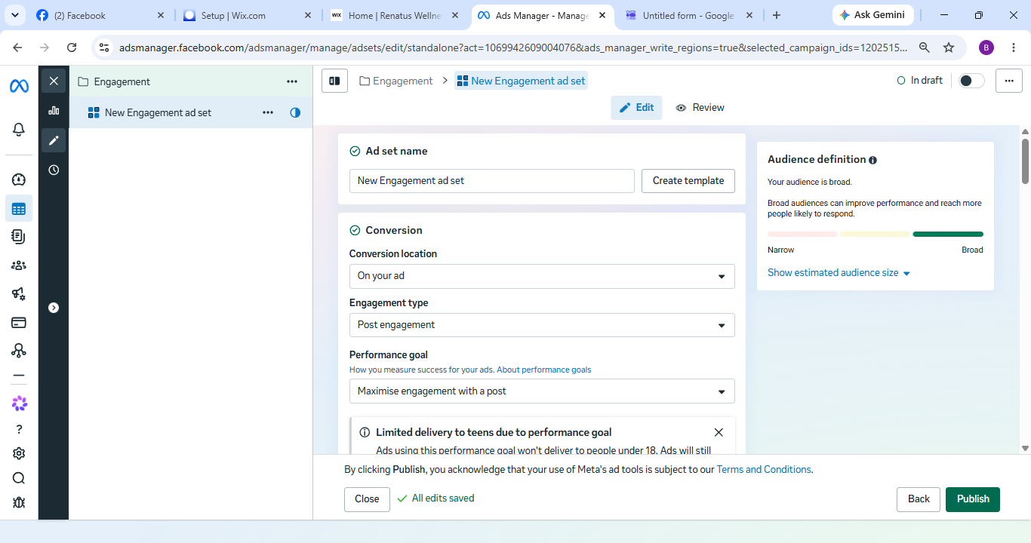
Perfomance Goals

Slide 14
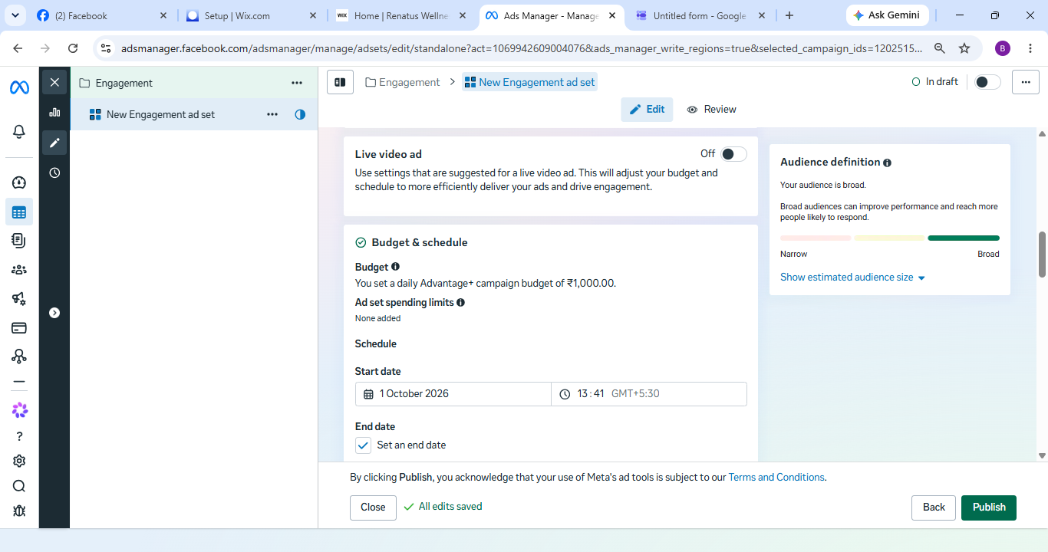
Budget & Schedule

Slide 15
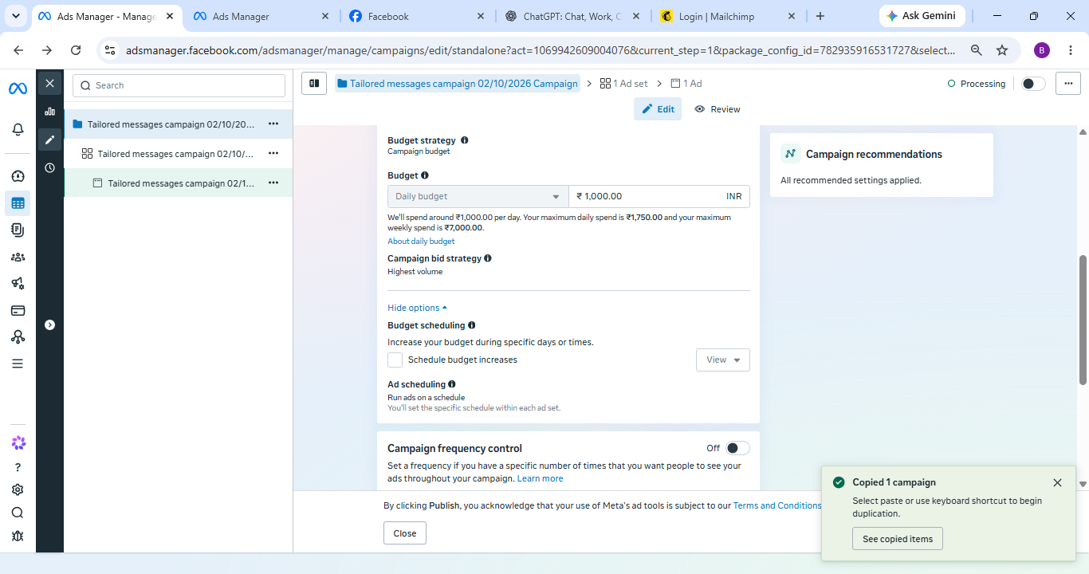
Budget & Schedule

Slide 16
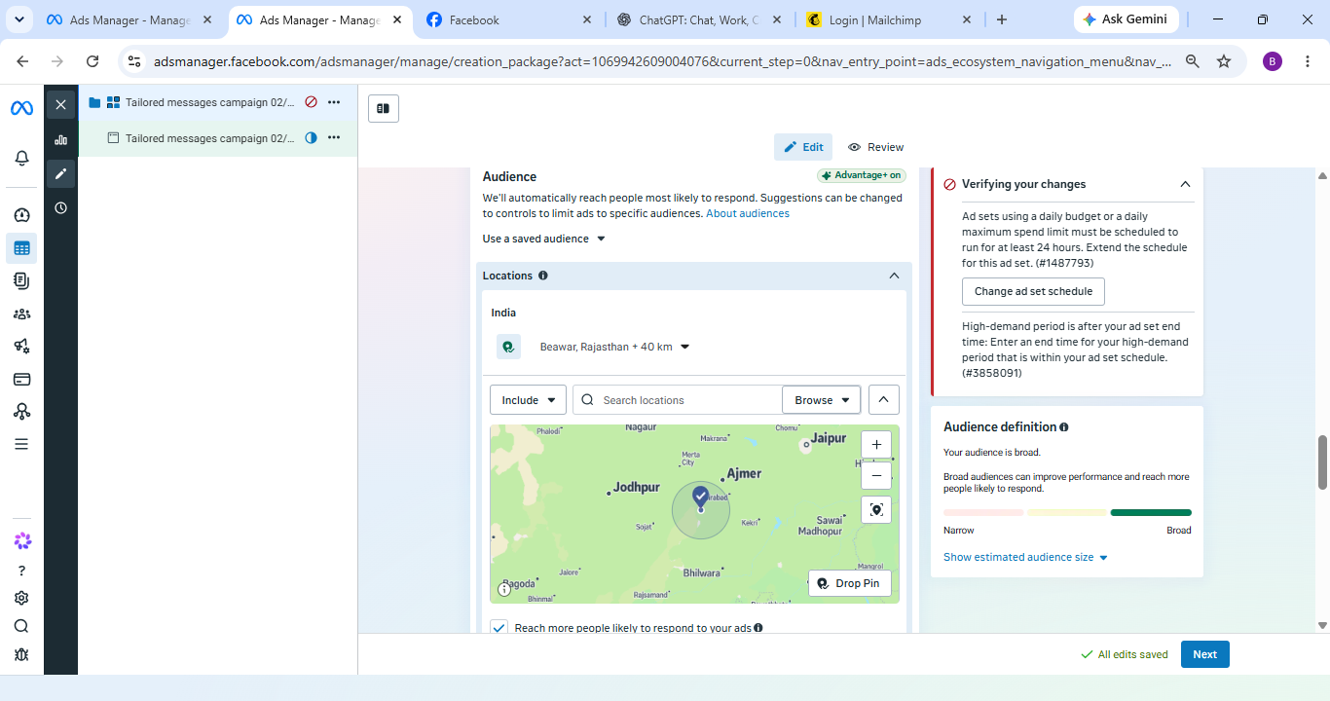
Audience Control

Slide 17
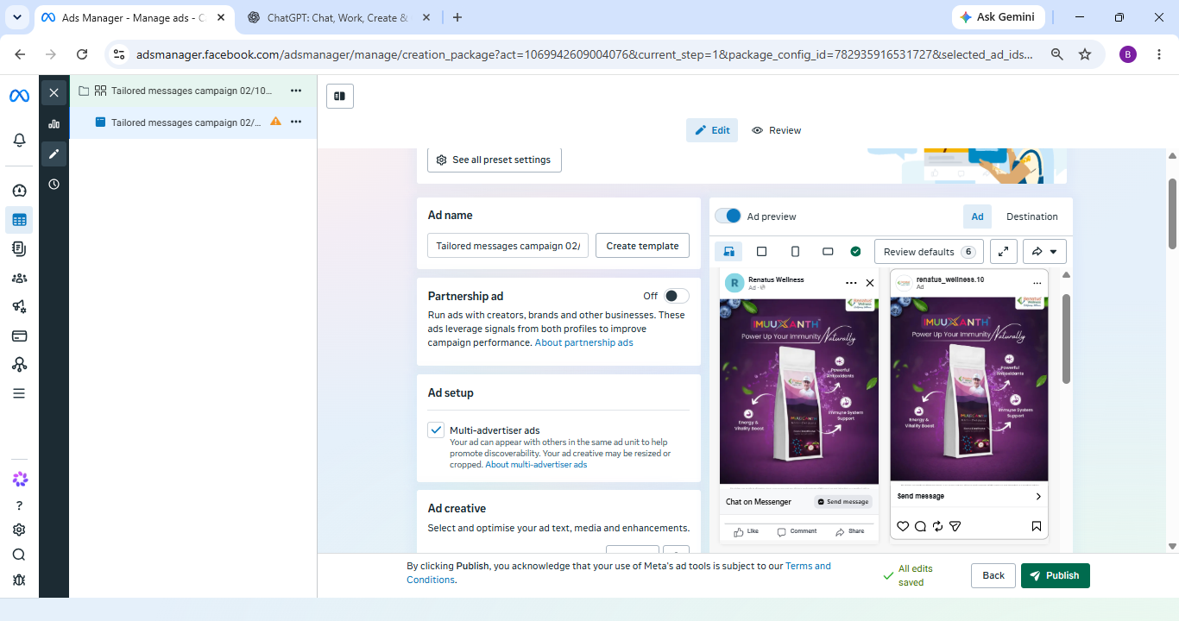
Set-up

Slide 18


